Slide 1
Chatting without Words: The Pictorial Senior Citizen Chat System
CS 3041 Project 3 Group 3: Team Kezzie
Brian McCarthy, Alex Titus, Jules Voltaire,
Ian Vossoughi, Adam Moran, Patrick Polley
Notes:
Patrick

Slide 2
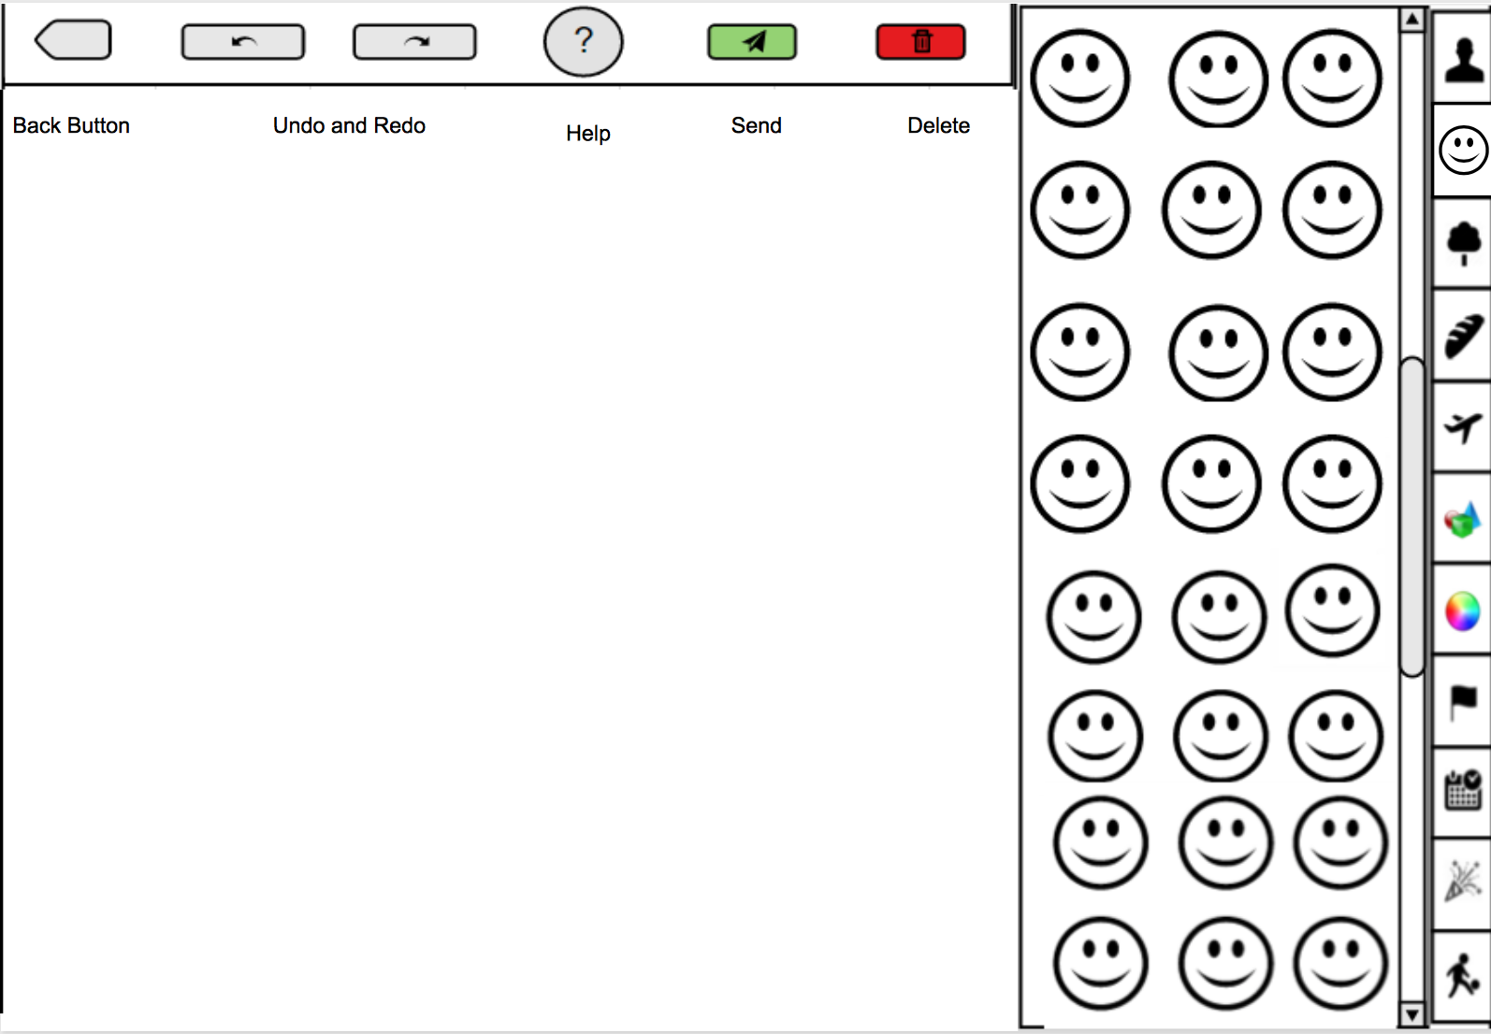
Basic Interface Design
Canvas-based design, drag icons from box onto the page and arrange them as they wish
Using arrows and dotted lines to convey connections
Automatic built-in arrows: as you drag modifying icons onto object icons, they will arrange by themselves
Radial based arrangement of icons on the canvas, freely adjustable by the user
Delete icons by dragging them out of the canvas (into the icon category)
Notes:
Patrick

Slide 3
Basic Interface Design
Delete entire sentence with a trash can button
Hold for 2 seconds to confirm deletion
Icon category can be changed via sidebar to quickly access the categories
Back button to return to the chat log
Undo/redo buttons above canvas
Help displays a short video simulating a user dragging icons onto canvas to form sentence
Retain the canvas objects when you’ve pressed Back to review what happened in the chat log
Notes:
Alex

Slide 4
Basic Interface Design and Rationale
Command menu
Icon bin
Categories
Humans/People
Emotions
Nature/Plants
Food and Drink
Transportation
Man-made Objects
Colors
Locations/Flags
Time/Date
Events
Actions
Canvas of Design
Notes:
Ian

Slide 5
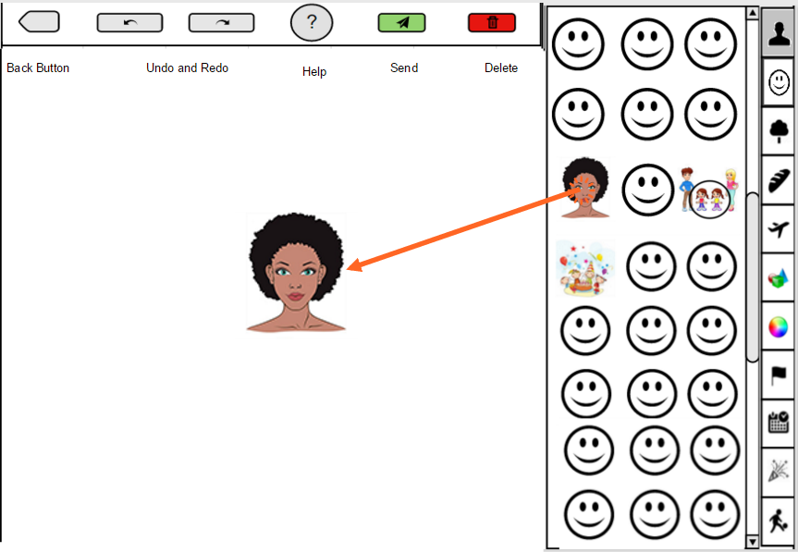
Adding an Icon
Notes:
Jules

Slide 6
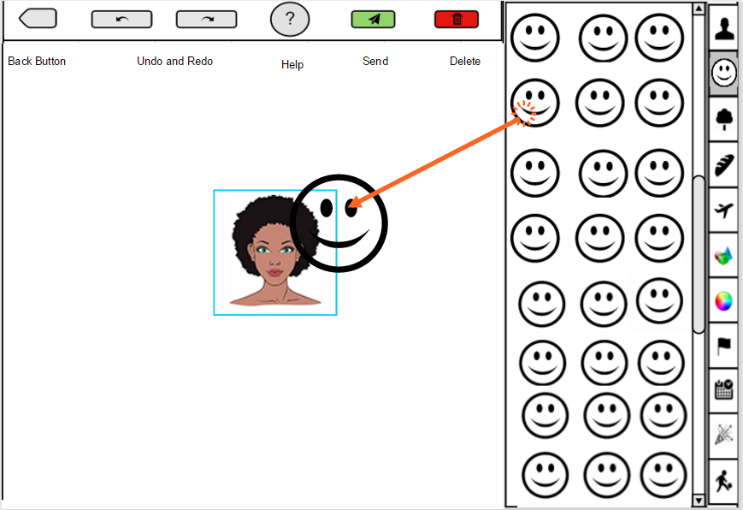
Adding a Modifier
Notes:
Jules

Slide 7
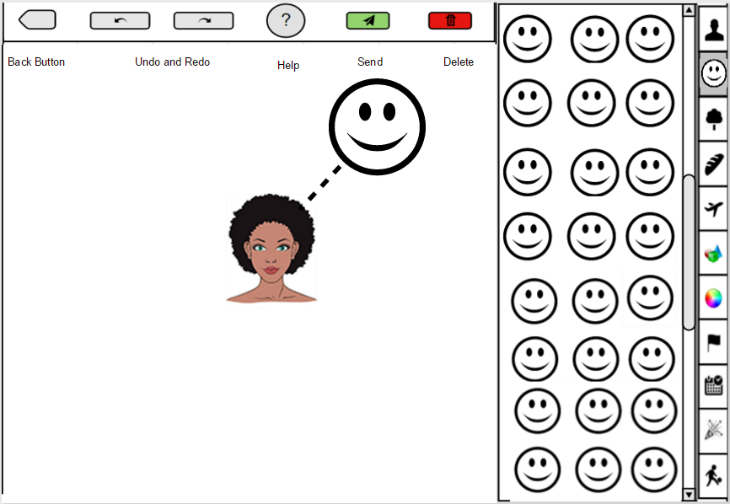
Modified Icon
Notes:
Jules

Slide 8
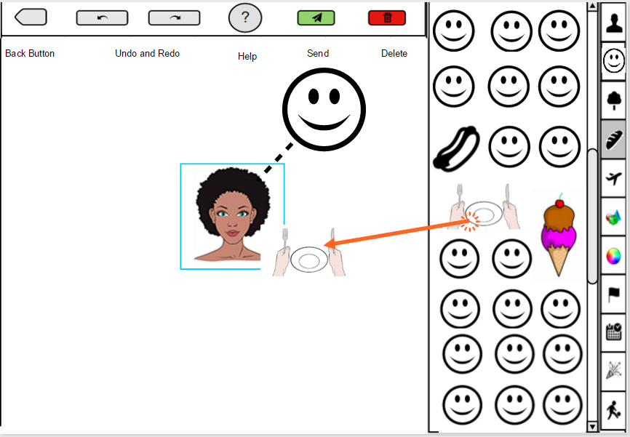
Adding new Icon
Notes:
Adam

Slide 9
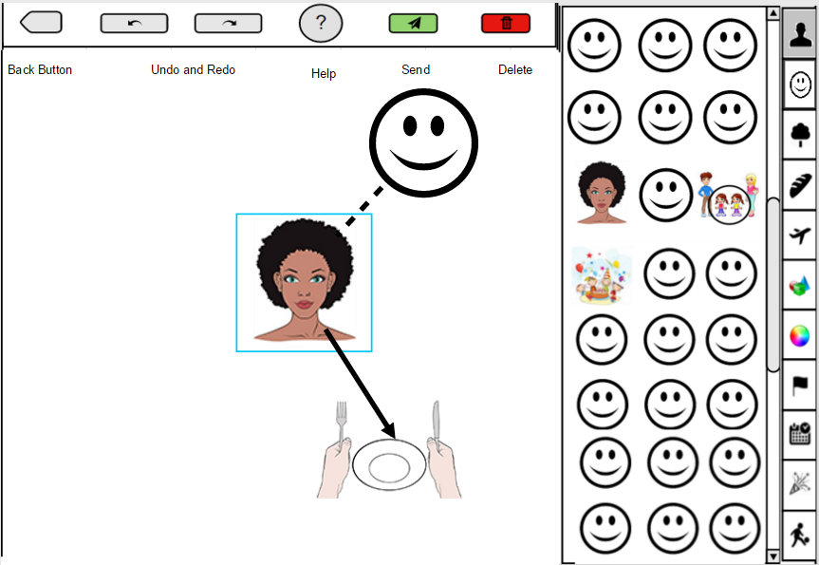
Adding a New Icon
Notes:
Adam

Slide 10
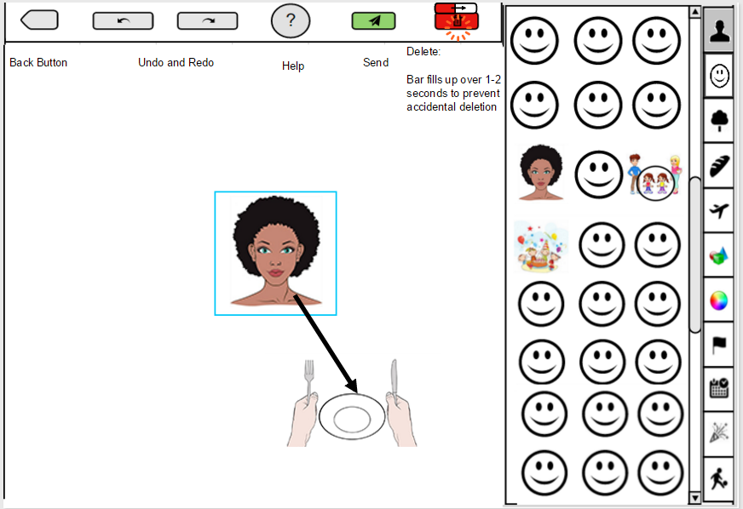
Deleting and Sending a Sentence
Notes:
Brian

Slide 11
Example Sentence
Kezzi became happy while eating ice cream on the big red London bus, as she remembered buying a necklace from her sister Anna at the birthday party in Hong Kong during the Winter last year.
Notes:
Brian

Slide 12
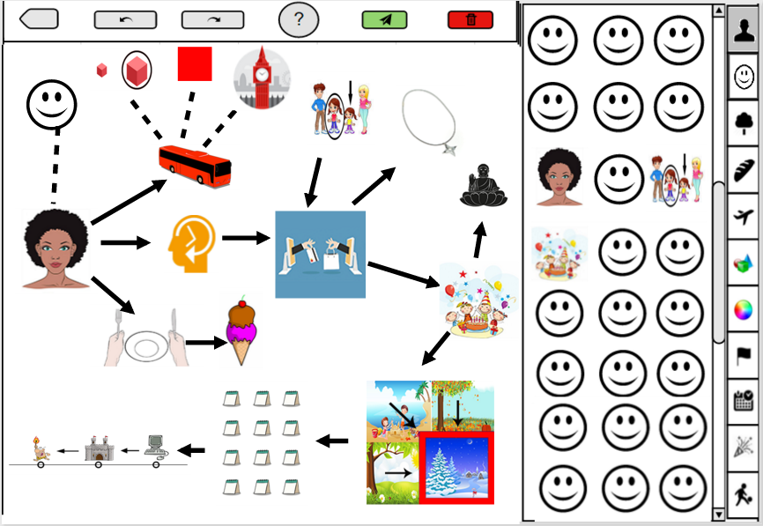
Notes:
Brian

Slide 13
Design Rationale
Interaction:
Drag-and-drop chosen for its natural, immediate familiarity over pie menus or tabbed hierarchies
Automated connectors used to produce consistent conventions among all users in modifying/connecting icons
Notes:
Ian

Slide 14
Design Rationale
Screen:
Canvas large enough to hold clear, distinctive icons
Menus are clear and unambiguous in meaning, but are not obtrusive to placing icons on canvas
Icons:
Designed for units of size to inhabit a grid-like format in bin
Cultural universality and familiarity prioritized over factual accuracy
Notes:
Ian

